Slide 1
Unit.1 Introducing C# and the .NET Framework
1.Object oriented programming:
OOP is a programming paradigm where programs are organized around objects rather than actions and data rather than logic.
It emphasizes the concept of "objects," which can contain data in the form of fields or attributes, and code in the form of procedures or methods.
Encapsulation, inheritance, polymorphism, and abstraction are the four fundamental principles of OOP.
Encapsulation refers to the bundling of data and methods that operate on the data into a single unit or class. This helps in hiding the internal state of an object and only exposing the necessary functionalities.
Inheritance allows new classes to be created based on existing classes, inheriting their attributes and methods. This promotes code reuse and helps in creating hierarchical relationships between classes.
Polymorphism allows objects of different classes to be treated as objects of a common superclass. It enables flexibility and extensibility in code design.
Abstraction refers to the process of hiding the complex implementation details and showing only the essential features of the object.
Examples of object-oriented programming languages include Java, C++, Python, and Ruby.

Slide 2
Why C# is OOP?
C# is rich in implementation of the object-orientation paradigm, which includes encapsulation, abstraction, inheritance, and polymorphism.

Slide 3
Introduction to C# Language
C# is a general –purpose, object-oriented programming language. C# was developed by Anders Hejlsberg and his team during the development of .Net Framework. It can be used to create desktop, web and mobile applications.
C# is a hybrid of C and C++; it is a Microsoft programming language developed to compete with Sun’s Java language.
The first version of C# was “C#1.0” released with visual studio .NET 2002.
C# is an elegant and type-safe object oriented language that enables developers to build a variety of secure and robust applications that run on the .NET Framework. You can use C# to create Windows client applications, XML Web services, distributed components, client server applications, database application, and much more.

Slide 4
Features of C#
It is modern, general-purpose programming language
It is object oriented.
It is component oriented
It is easy to learn
It is a structured language
It produces efficient programs
It can be complied on variety of computer platforms
It is a part of .Net Framework

Slide 5
Distinctive features from an object-oriented perspective:
Unified Type System: In C#, all types, including primitive types, user-defined types, and built-in types, are objects. This means that everything in C# is an object, and they all inherit from the common base type System.Object. This unified type system simplifies the language and promotes consistency in programming.
Classes and Objects: C# is built around the concept of classes and objects. Classes serve as blueprints for creating objects, encapsulating data (fields) and behaviors (methods) into a single unit. Objects are instances of classes, allowing for the creation of multiple independent instances with their own state and behavior.

Slide 6
Properties and Indexers: C# introduces properties and indexers, which provide a more flexible and intuitive way to encapsulate data and provide controlled access to class members. Properties allow for the definition of getter and setter methods for class fields, while indexers enable objects to be indexed like arrays.
Delegates and Events: C# supports delegates, which are type-safe function pointers that allow methods to be passed as parameters or stored as data. Delegates are used extensively for event handling, where they provide a mechanism for implementing the observer pattern.
Encapsulation, Inheritance, Polymorphism and abstraction etc.

Slide 7
Type Safety
C# is primarily a type safe language, meaning that instances of types can interact only through protocols they define, thereby ensuring each type’s internal consistency. For instance, C# prevents you from interacting with a string type as though it were an integer type.
Type safety helps catch errors during compilation rather than at runtime, leading to more robust and predictable code.
C# provides mechanisms such as static typing, meaning that language enforces type safety at compile time.

Slide 8
Memory Management
C# relies on the runtime to perform automatic memory management.
C# features automatic memory management through a process known as garbage collection. Garbage collection relieves developers from manually allocating and deallocating memory, reducing the risk of memory leaks.
When an object is no longer referenced by any part of the program, the garbage collector identifies it as unreachable and reclaims its memory

Slide 9
Platform support
Historically, C# was used almost entirely for writing code to run on Windows platforms. Recently, however, Microsoft and other companies have invested in other platforms, including Linux, macOs, and Android.
Xamarin allows cross platform C# development for mobile applications, and portable Class Libraries are becoming increasingly widespread.
Web Development: C# is widely used for web development. You can build server-side web applications using ASP.NET, which includes frameworks like ASP.NET Web Forms, ASP.NET MVC (Model-View-Controller), and ASP.NET Core. ASP.NET Core, in particular, is cross-platform and runs on Windows, macOS, and Linux.
Game Development: C# is a popular choice for game development, especially with the Unity game engine. Unity uses C# as its primary scripting language, allowing developers to create games for various platforms, including Windows, macOS, Linux, iOS, Android, and gaming consoles like PlayStation and Xbox.

Slide 10
A Simple C# Program
Let's begin in the traditional way, by looking at the code of a Hello World program
Using System;
Namespace Hello
{
class HelloWorld
{
static void Main()
{
// This is a single line comment
/* This is a
multiple
line comment */
Console.WriteLine("Hello World! ");
}
}
}
The first thing to note about C# is that it is case-sensitive. You will therefore get compiler errors if, for instance, you write 'console' rather than 'Console'.
The second thing to note is that every statement finishes with a semicolon (;) or else takes a code block within curly braces.

Slide 11
CLR( Common language Runtime)
CLR is the basic and Virtual Machine component of the .NET Framework. It is the runtime environment in the .NET Framework that runs the codes and helps in making the development process easier by providing the various services such as remoting, thread management, type safety, memory management, robustness, etc.
the Common Language Runtime (CLR) is a crucial component of the .NET platform, providing the infrastructure and services necessary for executing managed code efficiently, securely, and reliably
Here are some key aspects of the Common Language Runtime (CLR):
Execution Environment: The CLR provides a runtime environment in which managed code is executed. It manages memory, thread execution, code execution, code safety verification, compilation, and other essential runtime services.
Managed Code Execution: The CLR executes code written in .NET languages by converting it into machine code (Just-In-Time compilation) or intermediate language (IL) code (ahead-of-time compilation for .NET Core and .NET 5+). This process ensures that the code adheres to language and runtime rules, providing a level of safety and security.
Memory Management: The CLR includes a garbage collector that automatically manages memory by reclaiming memory occupied by objects that are no longer needed. This feature helps prevent memory leaks and reduces the burden on developers to manually allocate and deallocate memory.

Slide 12
Exception Handling: The CLR includes robust support for exception handling, allowing developers to write code that gracefully handles errors and exceptions. It provides mechanisms for catching and propagating exceptions across method boundaries and ensures that resources are properly released even in the presence of exceptions.
Debugging and Diagnostics: The CLR includes tools and APIs for debugging and diagnosing managed code. Developers can use debugging features in Visual Studio or attach debuggers to running processes to inspect variables, set breakpoints, and analyze the execution flow of managed code.

Slide 13
Introduction to .NET Framework
.NET is a software framework which is designed and developed by Microsoft. The first version of the .NET framework was 1.0 which came in the year 2002. The Microsoft .Net framework has come a long way since then, and the current version is .Net Framework 4.7.2.
It is a virtual machine for compiling and executing programs written in different languages like C#, VB.NET etc. it is used to develop Form-based applications, web based applications, and Web services and Mobile applications.
.NET Framework supports more than 60 programming languages in which 11 programming languages are designed and developed by Microsoft. Such as C#.NET, VB.NET, C++.NET, J#.NET, JSCRIPT.NET etc…

Slide 14
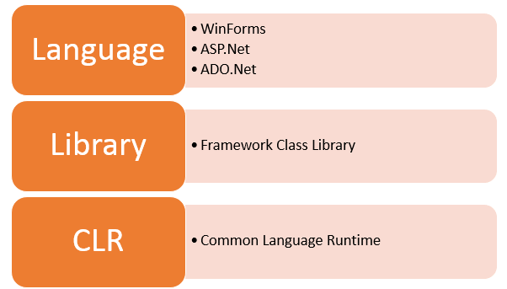
.NET Framework Architecture

Slide 15
1. Common Language Runtime
The “Common Language Infrastructure” or CLI is a platform in .Net architecture on which the .Net programs are executed.
The CLI has the following key features:
Exception Handling – Exceptions are errors which occur when the application is executed.
Garbage Collection – Garbage collection is the process of removing unwanted resources when they are no longer required.
Working with Various programming languages –
As noted in an earlier section, a developer can develop an application in a variety of .Net programming languages.
Language – The first level is the programming language itself, the most common ones are VB.Net and C#.
Compiler – There is a compiler which will be separate for each programming language. So underlying the VB.Net language, there will be a separate VB.Net compiler. Similarly, for C#, you will have another compiler.
Common Language Interpreter – This is the final layer in .Net which would be used to run a .net program developed in any programming language. So the subsequent compiler will send the program to the CLI layer to run the .Net application.

Slide 16
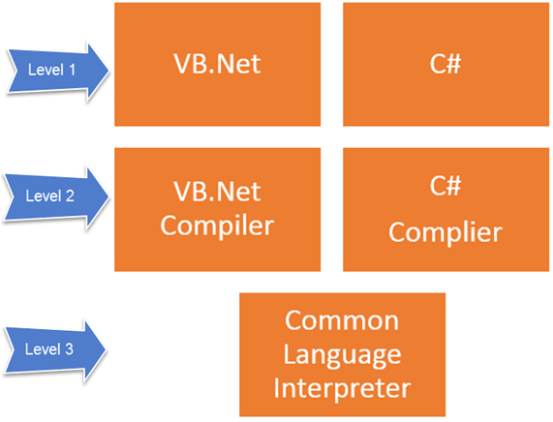

Slide 17
2. Framework Class Library(FCL):
It is the collection of reusable object-oriented class libraries and methods, etc. that can be integrated with CLR. Also called the Assemblies. It is just like the header files in C/C++ and packages in the java. Installing .NET framework basically is the installation of CLR and FCL into the system.
3. Languages
The types of applications that can be built in the .Net framework is classified broadly into the following categories.
WinForms – This is used for developing Forms-based applications, which would run on an end user machine. Notepad is an example of a client-based application.
ASP.Net – This is used for developing web-based applications, which are made to run on any browser such as Internet Explorer, Chrome or Firefox.
ADO.Net – This technology is used to develop applications to interact with Databases such as Oracle or Microsoft SQL Server.

Slide 18
.Net Framework Design Principle
The following design principles of the .Net framework is what makes it very relevant to create .Net based applications.
Interoperability – The .Net framework provides a lot of backward support. Suppose if you had an application built on an older version of the .Net framework, say 2.0. And if you tried to run the same application on a machine which had the higher version of the .Net framework, say 3.5. The application would still work. This is because with every release, Microsoft ensures that older framework versions gel well with the latest version
Portability – Applications built on the .Net framework can be made to work on any Windows platform. And now in recent times, Microsoft is also envisioning to make Microsoft products work on other platforms, such as iOS and Linux.
Security – The .NET Framework has a good security mechanism. The inbuilt security mechanism helps in both validation and verification of applications. Every application can explicitly define their security mechanism. Each security mechanism is used to grant the user access to the code or to the running program.

Slide 19
4) Memory management – The Common Language runtime does all the work or memory management. The .Net framework has all the capability to see those resources, which are not used by a running program. It would then release those resources accordingly. This is done via a program called the “Garbage Collector” which runs as part of the .Net framework. The garbage collector runs at regular intervals and keeps on checking which system resources are not utilized, and frees them accordingly.
5) Simplified deployment – The .Net framework also have tools, which can be used to package applications built on the .Net framework. These packages can then be distributed to client machines. The packages would then automatically install the application.

Slide 20
Other Frameworks
The Microsoft .NET Frameworks is the most expansive and mature framework, but runs only on Microsoft windows(desktop/server). Over the years, other frame-works have emerged to support other platforms. There are currently three major players besides the .NET Framework, all of which are currently owned by Microsoft.
Universal windows platform(UWP): For writing windows 10 store Apps and for targeting windows 10 devices.
.NET Core with ASP .NET Core : An open source framework for writing easily deployable internet apps and micro services that run on Windows, macOS, and Linux. Unlike the .NET Frame-work, .NET Core can be packaged with the web application
Xamarin: For writing mobile apps that target iOS, Android, and Windows Mobile. The Xamarian company was purchased by Microsoft in 2016.

Slide 21
.NET standard 2.0
NET Standard 2.0 is a version of the .NET Standard specification, which defines a set of APIs that must be available on all .NET implementations. It serves as a common ground for targeting multiple .NET platforms, ensuring compatibility and portability across different runtime environments.
Here are some key points about .NET Standard 2.0:
Compatibility: .NET Standard 2.0 is designed to be compatible with a wide range of .NET implementations, including .NET Framework, .NET Core, Xamarin, and Mono. It provides a common set of APIs that developers can rely on regardless of the specific runtime environment.
API Set: .NET Standard 2.0 defines a set of APIs that cover a broad range of functionality, including collections, I/O, networking, threading, XML, and more. These APIs are a subset of the APIs available in the full .NET Framework but are designed to be cross-platform and portable.

Slide 22
Versioning: .NET Standard uses a versioning scheme to specify which APIs are available in each version. Higher versions of .NET Standard include additional APIs and features compared to lower versions. .NET Standard 2.0 is one of the earlier versions of the specification and provides broad compatibility with existing .NET implementations.
Portability: .NET Standard 2.0 enables developers to write libraries and components that can run on any .NET implementation that supports .NET Standard 2.0 or higher. This simplifies the process of creating reusable code that can be shared across different projects, platforms, and ecosystems.
See the differene between .NET Framework, .NET Core, .NET standard

